Slide 1

Mailbox 0.1
github.com/lundstrj/mailbox/
The “problem”
Possible solution
Design considerations
What it looks like
What I would have/could have/should have done differently
LIVE demo (because pain is temporary but glory is forever)
Questions

Slide 2
Surprise!
(I am more than OK with you asking questions during the presentation, so please do, you know, if you want to.
There is also a dedicated slide at the end for those not brave enough to interrupt)

Slide 3
The “Problem”
(god forbid I’d get any accidental exercise)

Slide 4
Possible solution
(A possibly pervers abuse of clock cycles)

Slide 5
Design
(MVP, Cut scope, Always shippable master, Iterate)

Slide 6
High level
(You gotta have levels)

Slide 7
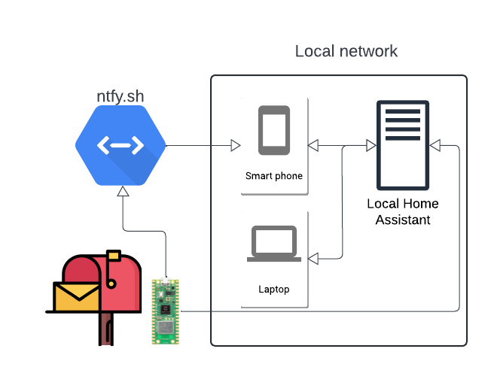

Slide 8
Low level
(Hardware)

Slide 9
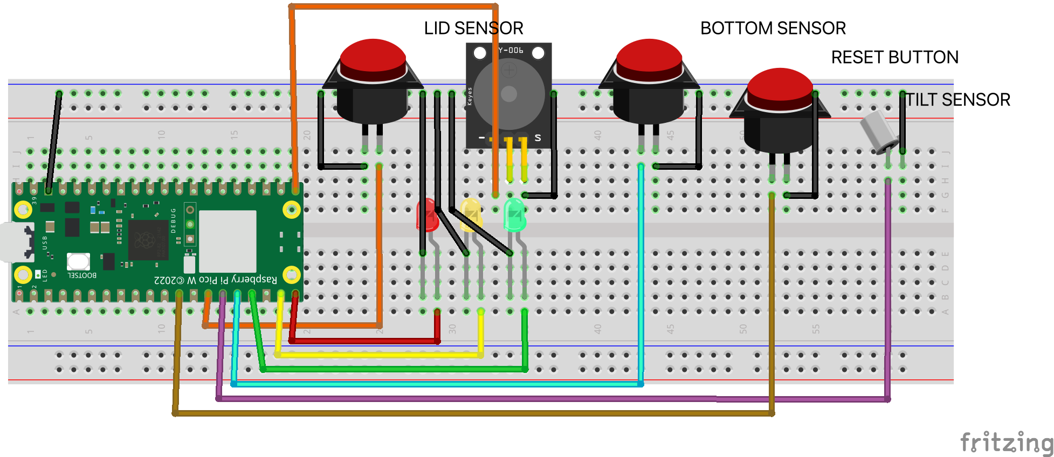
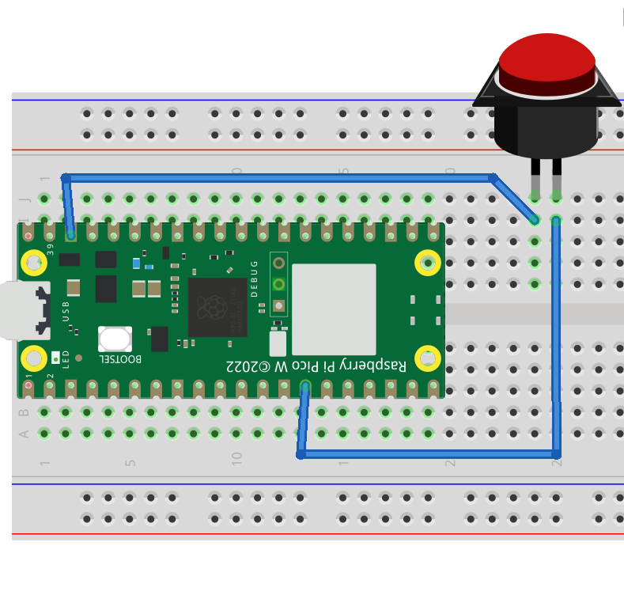
Fritzing

Slide 10
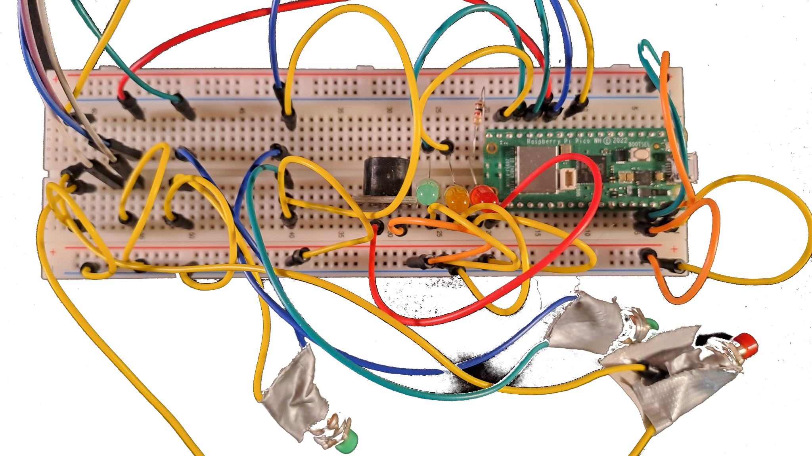
Photo

Slide 11
Medium level?
(Code)

Slide 12
Super simple
Init/setup/boot
  Load config
  Check configured pins
  Check configured credentials
  Connect to wifi
Main loop
  Sleep a little
  Sample sensors
  Evaluate the past x samples
  (maybe send request to Ntfy)
  (maybe send request to Home Assistant)

Slide 13
Do you want to see some code?
(Show me yours and I’ll show you mine)
(Feel the force, use the source)
(It really isn’t much to see but I’ll still show you)

Slide 14
Woulda, Coulda, Shoulda
(Also known as learning)

Slide 15
Who doesn’t love a live demo?
(What could possibly go wrong)

Slide 16
Questions
(Fire away)

